Slide 1
Building Multi-language Reports in Power BI
Ted Pattison
Principal Program Manager
Power BI Customer Advisory Team (PBICAT)

Slide 2
Agenda
Overview of Building Multi-language Reports
Extending a Dataset with Metadata Translations
Implementing Report Label Translations
Designing a Data Translations Strategy

Slide 3
Building Multi-language Reports in Power BI
Power BI provides Internationalization and localization features
You can design report that render in English, Spanish, French and German
It's no longer necessary to copy/maintain a separate PBIX file per language
Building multi-language reports will decrease maintenance and overhead
Recent Power BI Enhancements for Building Multi-language Reports
USERCULTURE function now supported and used to create measures with dynamic translations
More properties for report visuals and shapes can be dynamically bound to DAX measures
Introduction of Field Parameters offers much better options to implement data translations
This guidance is based on using an external tool named Translations Builder
Translations Builder is open-source tool designed to work with Power BI Desktop

Slide 4
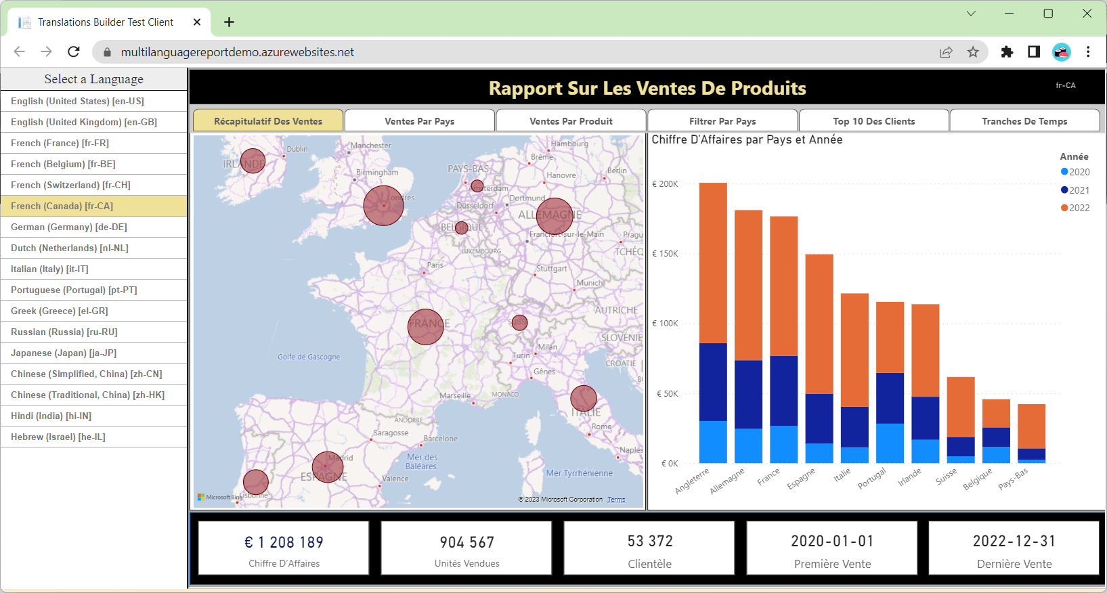
Multi-language Report Live Demo
https://multilanguagereportdemo.azurewebsites.net

Slide 5
Power BI Support for Metadata Translations
Power BI supports metadata translations for the properties of dataset objects
Supported object types include Table, Column, Measure, Hierarchy and Hierarchy Level
Supported object properties include Caption, Description and DisplayFolder
Metadata translations currently require Power BI Premium – not supported in shared capacity
Metadata translations only supported for Power BI datasets – not for report layouts
Report Layout does not support localization
Dataset Definition
supports localization
Metadata translations stored inside context of dataset definition
PBIX File (ProductSales.pbix)

Slide 6
Understanding the Three Types of Translations
Metadata translations (always required)
Translations for dataset object names such as tables, columns and measures
Report label translations (always required)
Translations for literal string values used in report
Provides localized text for report titles, section headings, button captions, etc.
Data translations (sometimes required)
Translations of text-based column values in the rows of underlying data being analyzed

Slide 7
Understanding Culture Names
Power BI Service loads every report with specific user context
User context identifies a specific language and a specific locale
Locale identifies a geographical region which is usually a country
Power BI Service tracks combination of language and locale using a culture name
Example culture names
A culture name of en-US identifies a user in the United States that speaks English
A culture name of es-ES identifies a user in Spain that speaks Spanish
A culture name of fr-FR identifies a user in France that speaks French
A culture name of de-DE identifies a user in Germany that speaks German
Culture name | Language | Locale
en-US | English | United States
es-ES | Spanish | Spain
fr-FR | French | France
de-DE | German | Germany

Slide 8
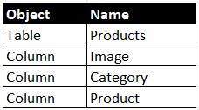
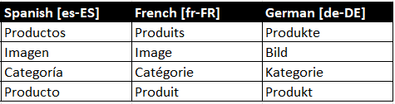
Extending a Dataset with Metadata Translations
Dataset objects have names
Dataset object names created using default language of hosting dataset
Dataset objects can be extended by adding metadata translations
Each set of metadata translations added to dataset using culture name as key
Dataset Definition
Default Language=en-US
Dataset Objects
Metadata Translations

Slide 9
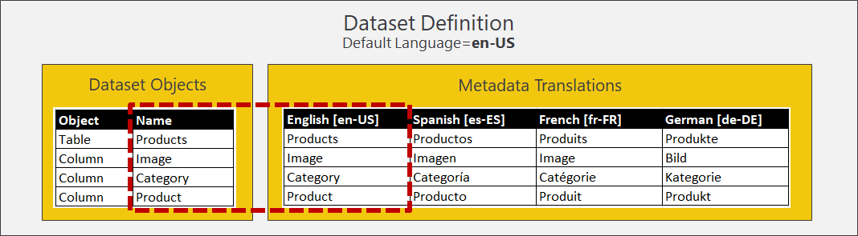
Metadata Translations for the Default Language
There is no need to supply metadata translations for default language
Power BI loads dataset object names if no metadata translations exist for default language
Dataset object names serve as virtual set of metadata translations for default language
It is possible to explicitly add metadata translations for default language, but….
Power BI Desktop always loads dataset object names instead of metadata translations
Power BI Service in some cases loads dataset object names instead of metadata translations

Slide 10
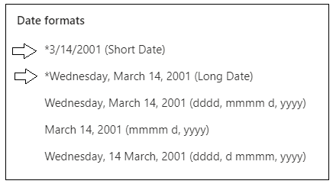
Formatting Dates and Numbers with Current User Locale
Power BI visuals inspect locale of current user when formatting numbers and dates
In most cases, visual will display values with correct formatting for current user’s locale
Make sure you use column and measure format strings that support regional formatting
Example of Short Date format string across different locales
en-US | 12/31/2022
en-GB | 31/12/2022
pt-PT | 31-12-2022
de-DE | 31.12.2022
ja-JP | 2022/12/31

Slide 11
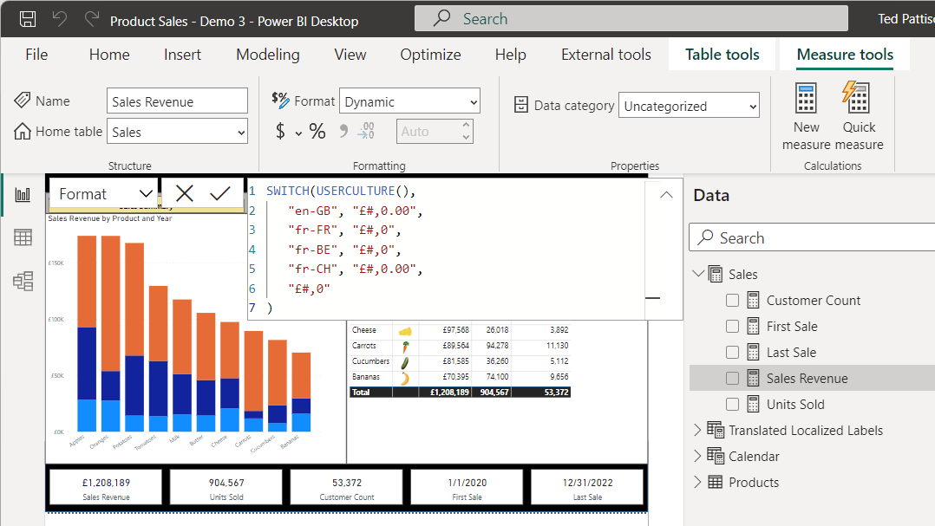
New Feature - Dynamic Format String
Allows for dynamic calculation of format string based on USERCULTURE
In preview, dynamic format string only supported for measures with numeric datatypes
https://learn.microsoft.com/power-bi/create-reports/desktop-dynamic-format-strings
Avoid creating dynamic format strings that inspect USERCULTURE
Only use this approach if problem cannot be solved using locales and static format string

Slide 12
Agenda
Overview of Building Multi-language Reports
Extending a Dataset with Metadata Translations
Implementing Report Label Translations
Designing a Data Translations Strategy

Slide 13
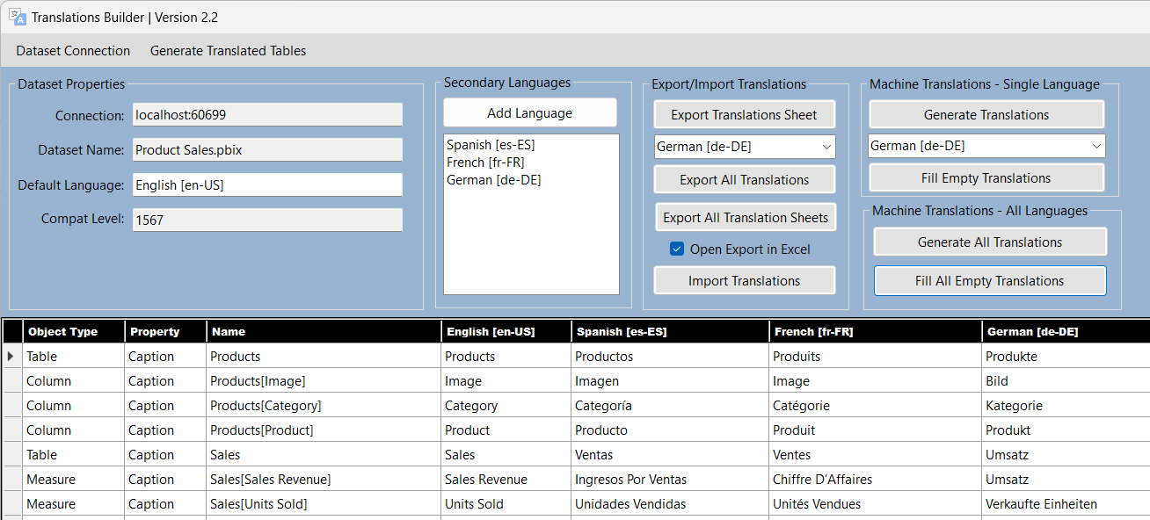
Translations Builder 2.2
Translations Builder is tool designed for content creators using Power BI Desktop
Content creators can use this tools to add multi-language support to PBIX project files
Provides support for working with (1) metadata translations and (2) report label translations
Translations Builder v2.2 supports metadata translations for multiple locales for same language

Slide 14
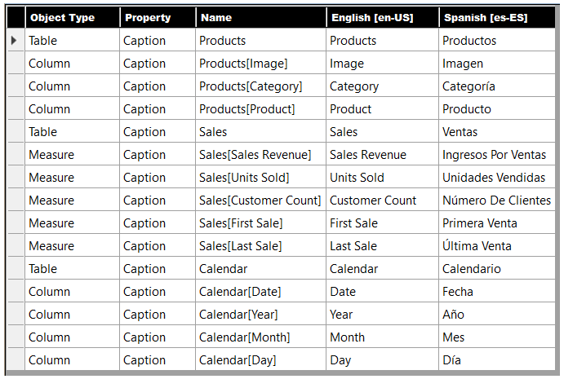
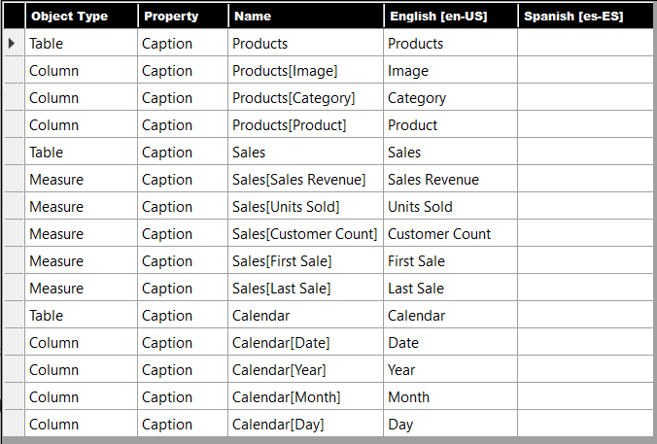
Generating Machine Translations
Translations Builder supports generating machines translation
Machine translations generated using Azure Translator Service
Translations Builder provides commands to automatically populate metadata translations
Translations Builder
Azure
Translator
Service

Slide 15
Testing Metadata Translations in Power BI Service
Metadata translations cannot be tested in Power BI Desktop
Analytics engine for Power BI Desktop does not load metadata translation
Dataset and report(s) must be published to Premium workspace in Power BI Service for testing
Workflow for Building Multi-language Reports
Add translations to dataset PBIX project file using Translations Builder
Save PBIX project file in Power BI Desktop and publish to the Power BI Service
Test translations in Power BI Service using language parameter on report URL
Repeat steps 1-3

Slide 16
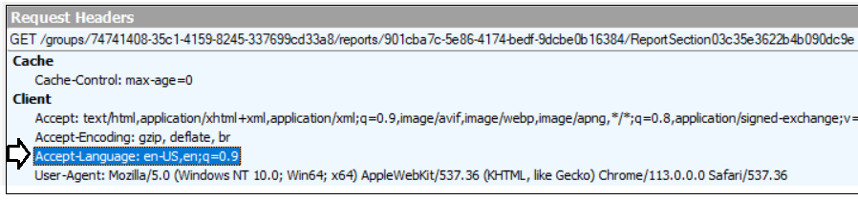
Power BI Reports Load with Language and Locale of User
Every report loads with a specific language and a specific locale
Default behavior is to load report with language and locale passed in Accept-Language header
Value passed in in Accept-Language header configured with OS-level or browser settings
You can override Accept-Language header value by using language report URL parameter

Slide 17
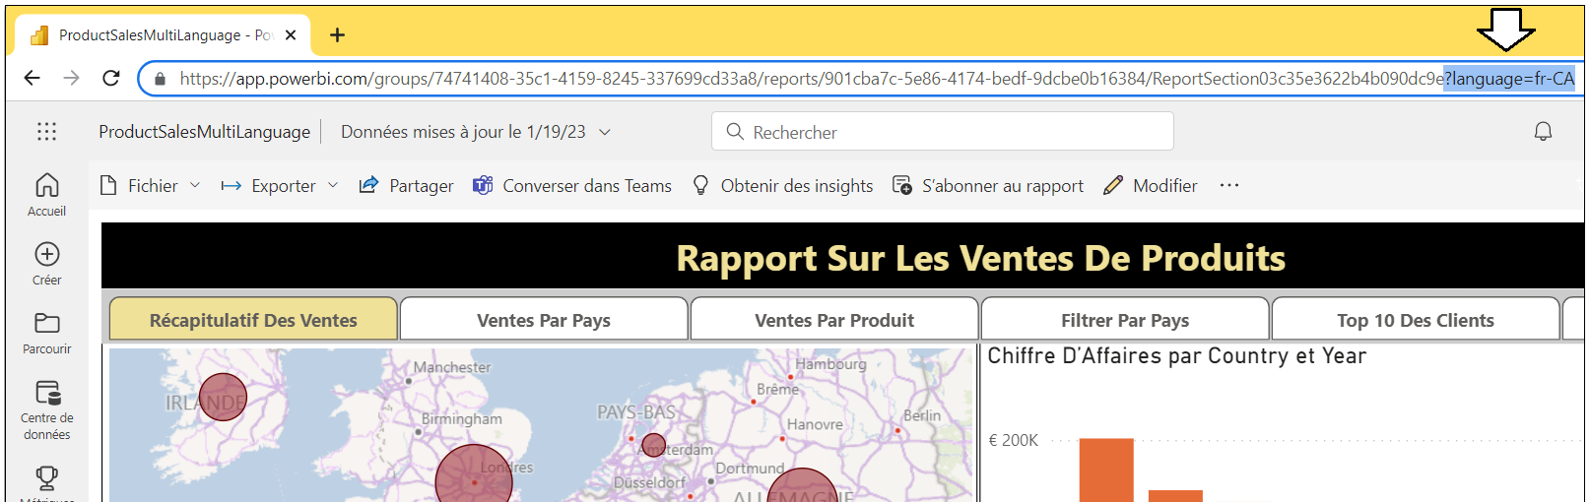
Loading Reports using the Language Parameter
Culture name used to load report can be overridden using language parameter
You do this by adding language parameter to the end of a Power BI report URL
Adding the language parameter to a report URL can be handy during testing
language parameter provides quick way to test without changing settings for OS or browser

Slide 18

Supporting Multiple Locales for a Single Language
Think about a scenario involving multiple locales for single spoken language
Dataset has default language of en-US and metadata translations for es-ES, fr-FR and de-DE
User who speaks French in Canada opens a report which loads with culture name of fr-CA
QUESTION: Should Power BI load translations for en-US and fr-FR?
Power BI has had a problem with predictable metadata translation loading behavior
Translation loading behavior for measures has been different than for tables and columns
Moving forward, measure loading behavior will be modified to match tables & columns
Power BI will load metadata translations only when there’s exact match for entire culture name
You must supply metadata translations separately for fr-FR, fr-BE and fr-CA to support all locales
Dataset
Browser
Accept-Language: fr-CA
Which Translations Should be Loaded?
Translations:
en-US (default)
es-ES
fr-FR
de-DE

Slide 19
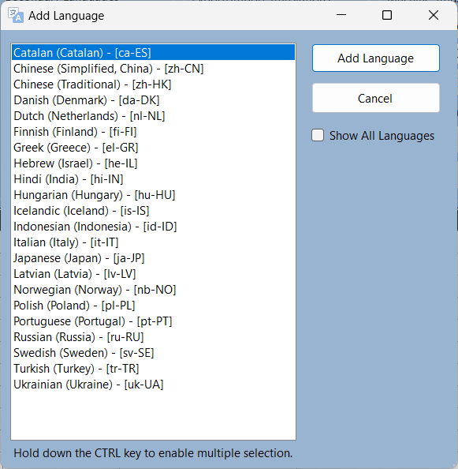
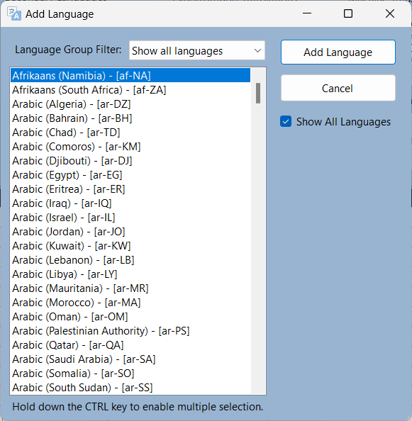
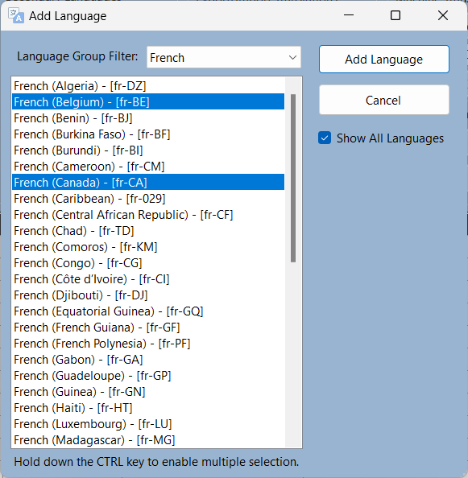
Adding Languages in Translations Builder 2.2
Translations Builder introduces support for multiple culture names for single language
Spoken language referred to as Language Group in Add Language dialog
Makes it easy to add multiple languages (i.e. culture names) for a single Language Group

Slide 20
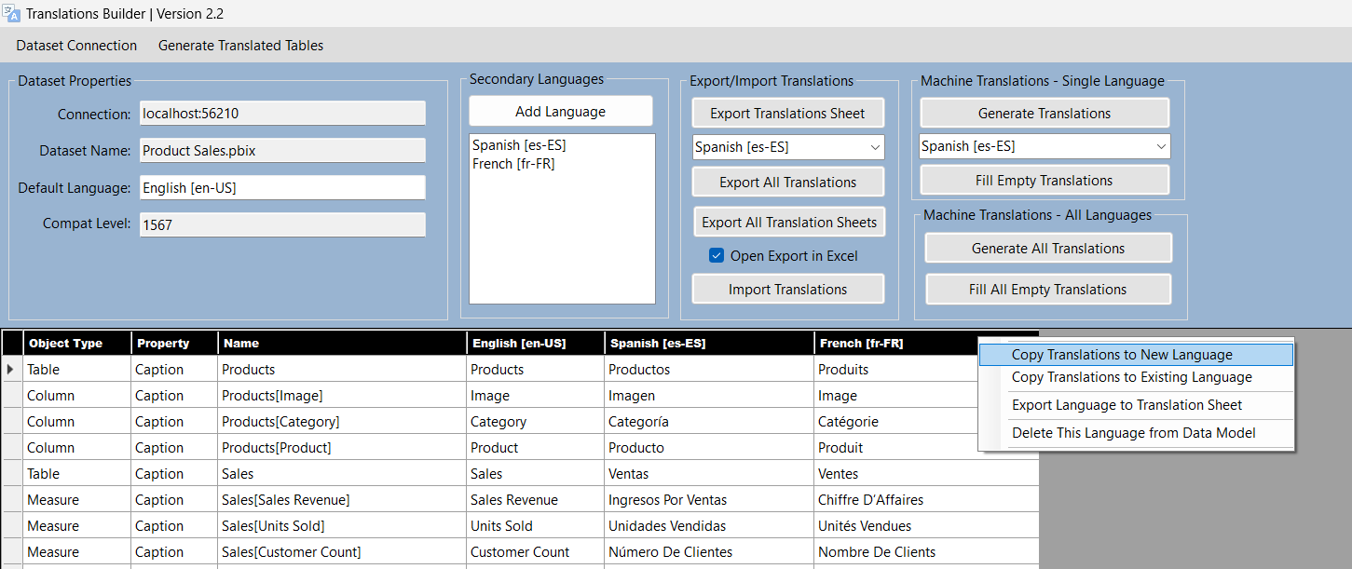
Convenience Commands in Translations Builder 2.2
Right-clicking on column header provides to Copy command
Copy Translations to New Language to clone translations to new language column
Copy Translations to Existing Language to copy/overwrite translations in existing language columns

Slide 21
Agenda
Overview of Building Multi-language Reports
Extending a Dataset with Metadata Translations
Implementing Report Label Translations
Designing a Data Translations Strategy

Slide 22
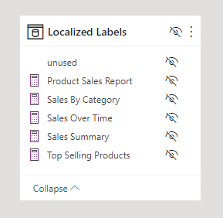
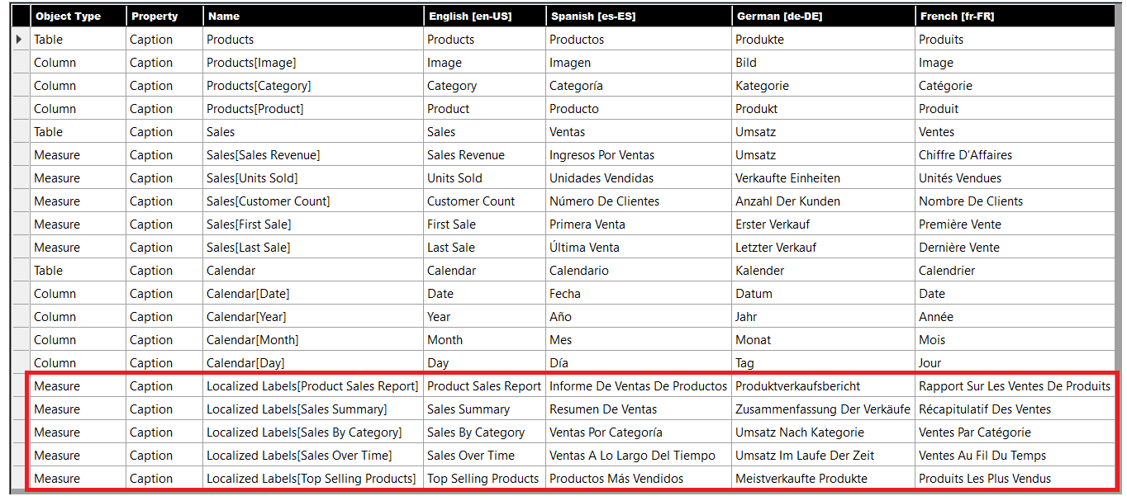
Translations Builder uses Localized Labels Table Strategy
Translation Builder uses innovative approach to track & surface report label translations
Strategy based on creating hidden table in data model named Localized Labels
For each report label, a new measure is added to Localized Labels table
Translations for report labels tracked as metadata translations for their associated measure

Slide 23
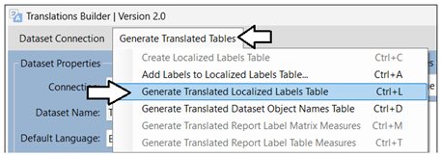
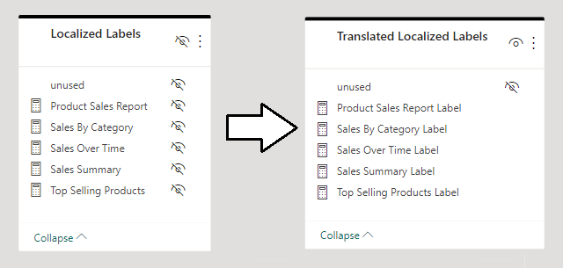
Generating the Translated Localized Labels Table
Localized Labels table does not provide easy way to surface report labels in report
Translations for Localized Labels table used to generate Translated Localized Labels table
Table created and updated using Generate Translated Localized Labels Table command
Unlike Localized Labels table, the Translated Localized Labels table is visible in Report view

Slide 24
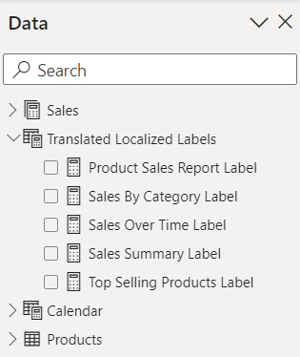
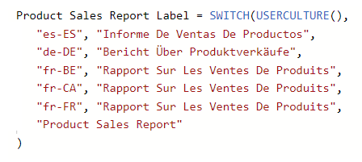
Using Measures from Translated Localized Labels Table
Translations Builder generates measures to implement report label translations
Measured created for report authors in new table named Translated Localized Labels
SWITCH function inspects USERCULTURE and culture name to dynamically implement translations
Multiple locale identifiers for same language (fr-FR, fr-BE and fr-CA) should be split out separately
Pattern falls back on the default language (en-US) when there is no match

Slide 25
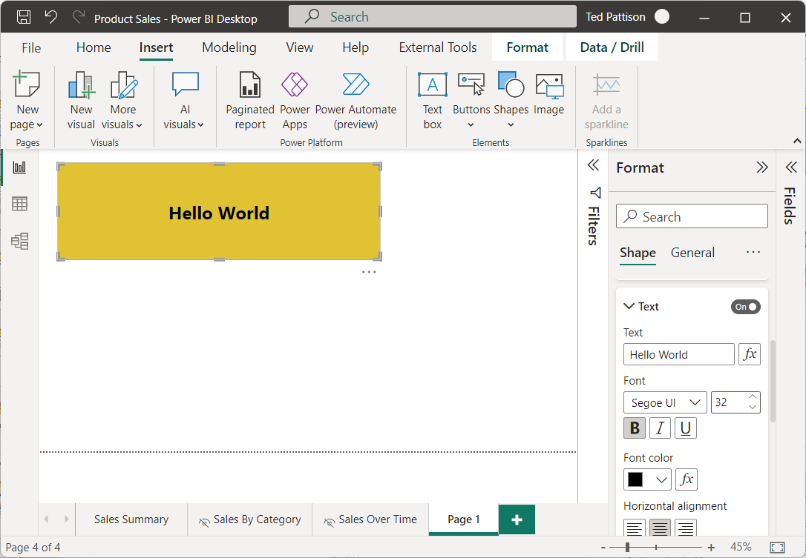
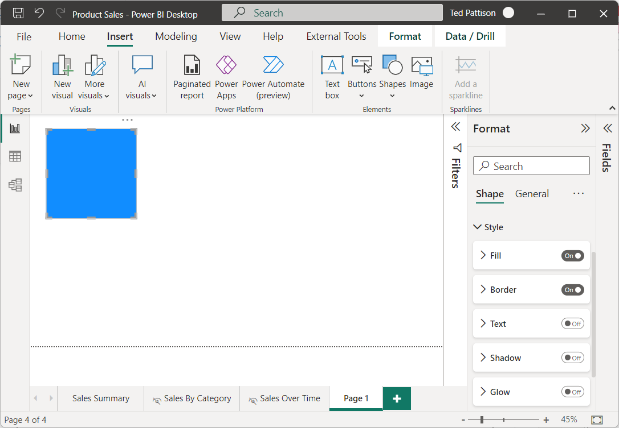
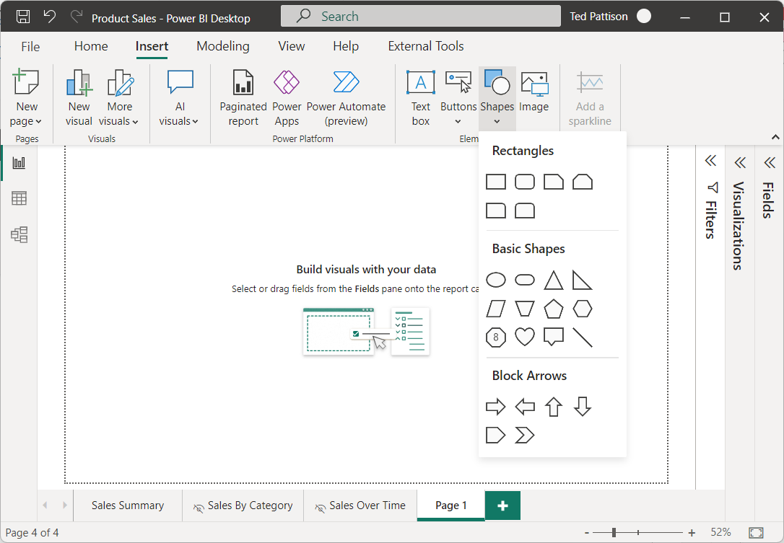

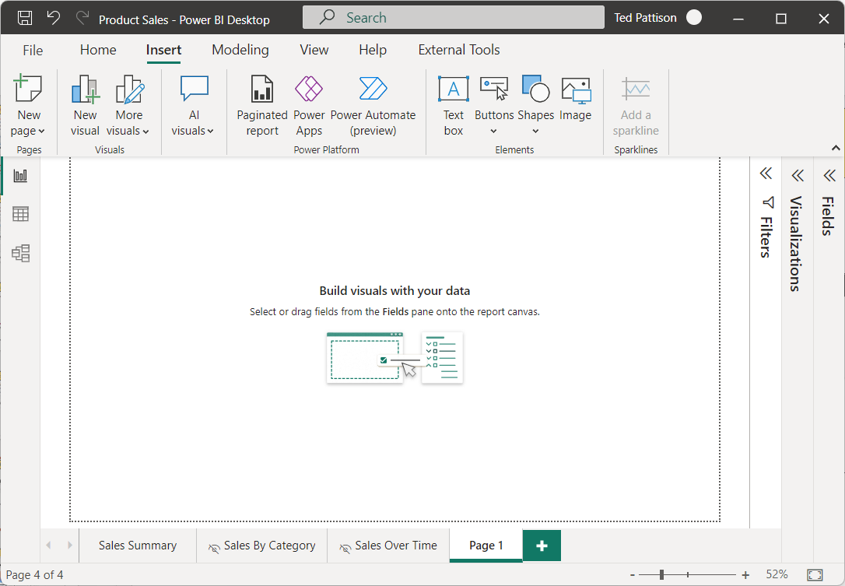
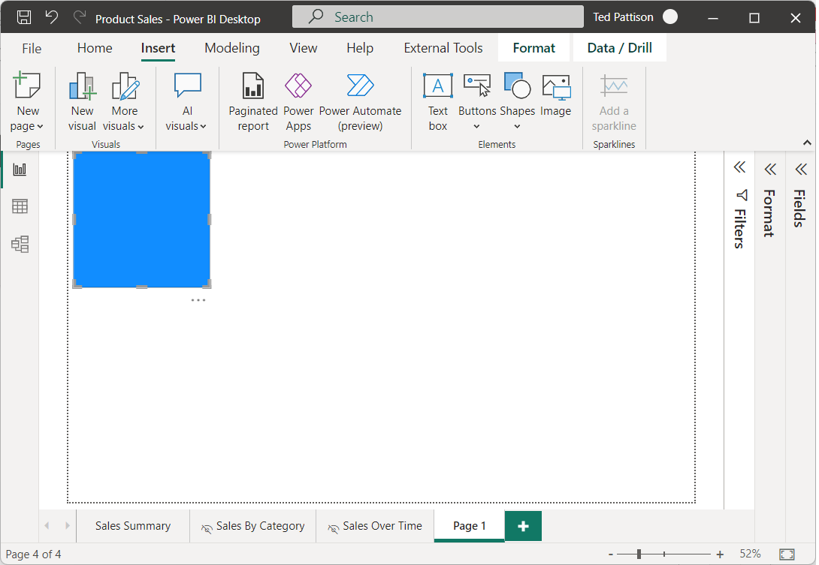
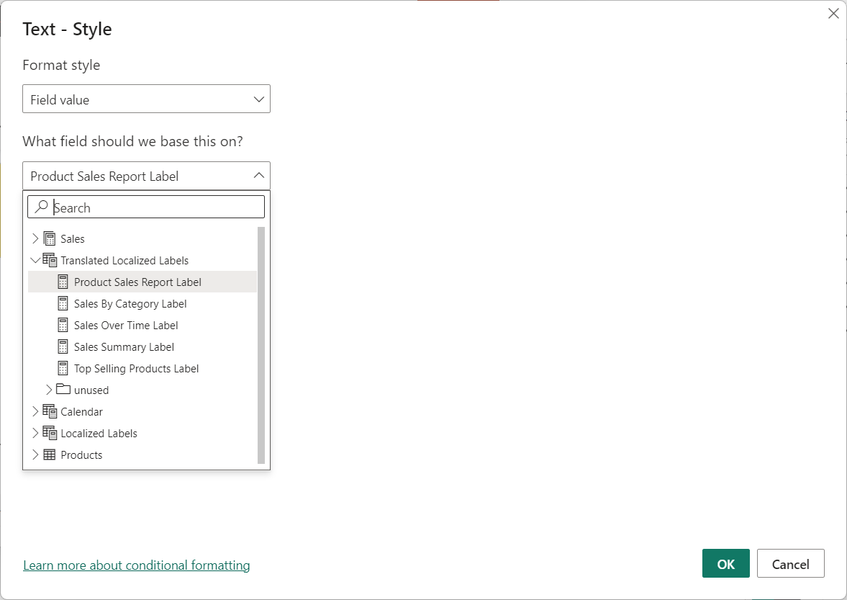
Using Shapes to Surface Report Labels
Shapes such as Rectangle provide great way to surface report labels

Slide 26
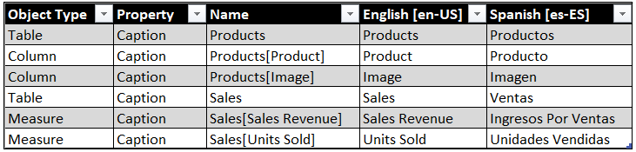

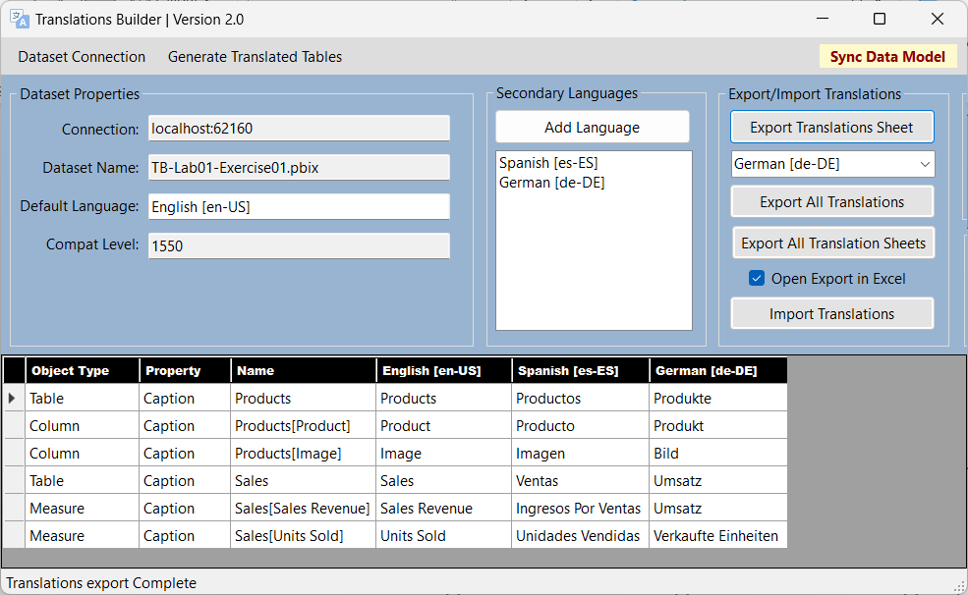
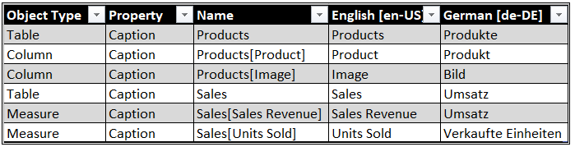
Using Translation Sheets to Integrate Human Translations
Translations Builder uses translation sheets to integrate work of human translators
Translation sheets are CSV files generated using Export Operations
Translation sheets sent to human translators
Human translators update translations sheets and return them
Translations from updated translation sheet integrated back into data using Import Operation
Outbox
Project1-Translations-Spanish.csv
Export Translation Sheet
Project1-Translations-German.csv
Export Translation Sheet
Inbox
Import Translation Sheet
Project1-Translations-Spanish.csv
Import Translation Sheet
Project1-Translations-German.csv

Slide 27
Enterprise Level Management of Translations
Translations can be moved between PBIX projects using master translation sheets
Logic built into Import operation
Include metadata translations for any dataset objects that exist in target dataset
Ignore metadata translations for any dataset objects that do not exist in target dataset
Add secondary languages and their translations if language does not exist in target dataset
Add Localized Labels table and report label translations if they do not exist in target dataset
PBIX Project 1
Master
Translation
Sheet
PBIX Project 2
Export Operation
Import Operation

Slide 28
Enterprise Level Management
It’s possible to create and maintain enterprise-level master translation sheet
Initialize new PBIX projects with a reusable set of localized report labels
Initialize new PBIX projects with translations for common schema of dataset objects
New PBIX
Project 1
Enterprise Master
Translation Sheet
Import Operation
Import Operation
New PBIX
Project 2
Import Operation
New PBIX
Project 3

Slide 29
Agenda
Overview of Building Multi-language Reports
Extending a Dataset with Metadata Translations
Implementing Report Label Translations
Designing a Data Translations Strategy

Slide 30
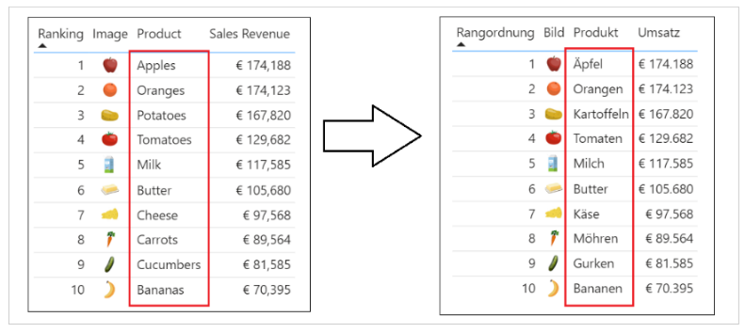
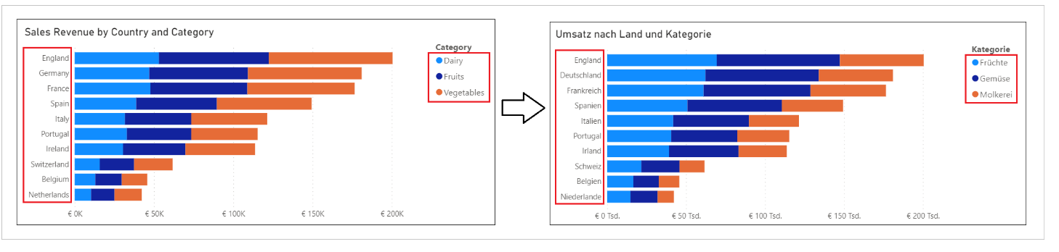
Data Translations
Data translations used to localize text values from underlying rows of data
Examples in the live demo include translated names for products, categories and countries
Data translations require the most effort to implement
It’s a best practice to implement data translations using the new Field Parameter feature

Slide 31
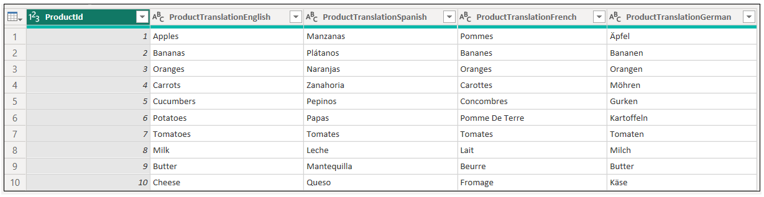
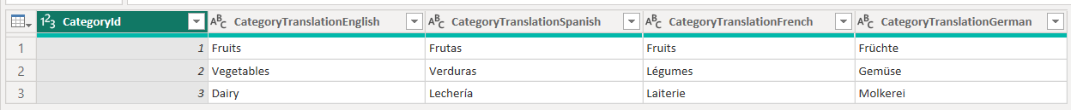
Extending the Datasource with Data Translation Columns
Data translation implementation starts with modifying datasource schema
Tables must be extended by adding one data translation column per language
Products table extended with 4 columns with translated product names
Categories table extended with 4 columns with translated product category names

Slide 32
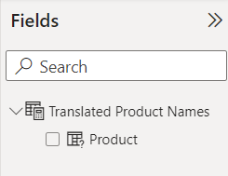
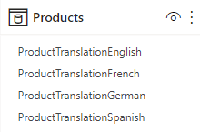
What is a Field Parameter?
Field Parameter is a table in which each row represents a field
You can think of a Field Parameter as a collection of fields
The rows of a Field Parameter can be filtered
You can think of Field Parameter as a filterable collection of fields
Field Parameter can be configured to act as a column selector
Exposed as single field for report layout that can be switched between columns (i.e. languages)
column
selector

Slide 33
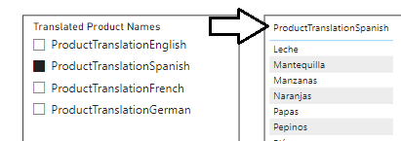
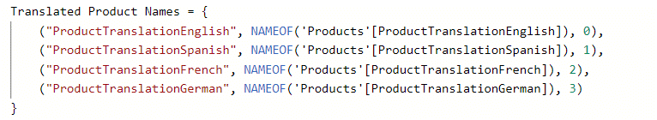
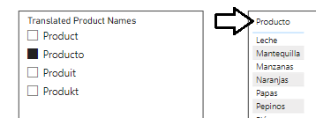
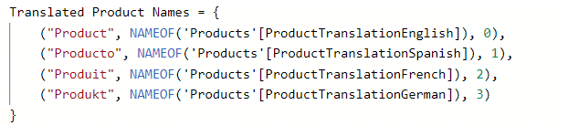
Localizing Field Names in a Field Parameter
Field names in a Field Parameter originally based on datasource column names
Names of fields are hard-coded in DAX expression and are not localized
Update field names in DAX expression to support localization

Slide 34
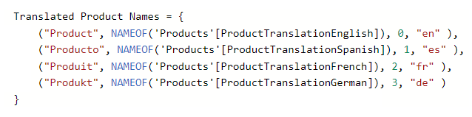
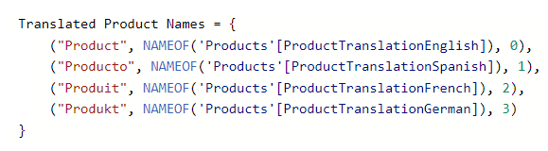
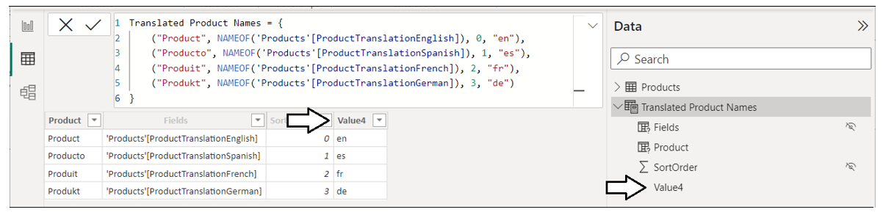
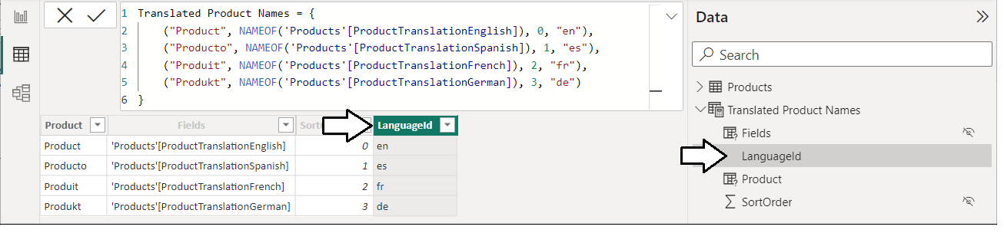
Extending Field Parameter with LanguageId Column
You can modify Field Parameter DAX expression to add new columns
New column named Value4 should be renamed to LanguageId

Slide 35
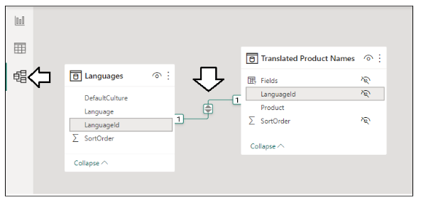
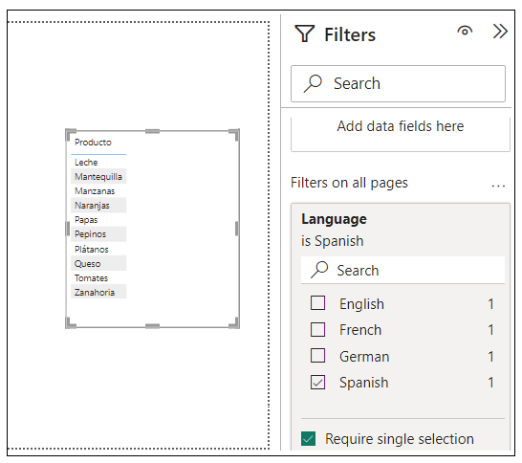
Filtering Field Parameters with the Languages Table
Create one-to-one relationship between Languages table and Field Parameter
Relationship based on LanguageId column
Selecting single row in Languages table selects single language column in Field Parameter

Slide 36
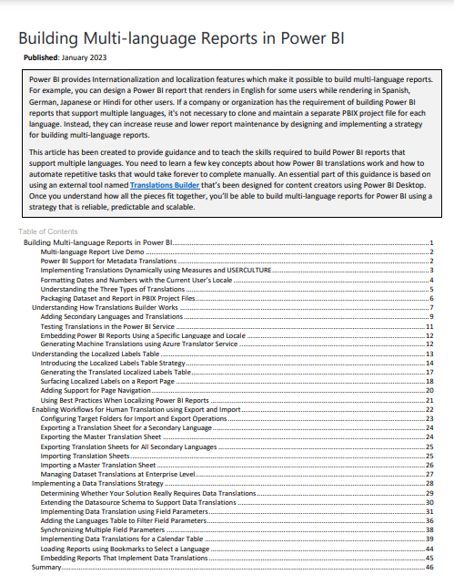
Call to Action – Read Our Guidance Document
Building Multi-language Reports in Power BI
https://aka.ms/MultiLanguageReportGuidance

Slide 37
Try Out Our New Hands-on Lab Exercises
Hands-on Lab: Building Multi-language Reports for Power BI
https://aka.ms/MultiLanguageReportLab
Sequence of lab exercises
Exercise 1: Creating and Testing Metadata Translations
Exercise 2: Generating Machine Translations
Exercise 3: Creating and Testing Report Label Translations
Exercise 4: Creating a Workflow Process To Gather and Integrate Human Translations
Exercise 5: Implementing Data Translations using Field Parameters
Exercise 6: Implementing Data Translations for a Calendar Table

